Slide 1


Day 24
contact@anubhavtrainings.com
ABAP RESTFUL APPLICATION PROGRAMMING

Slide 2

Agenda – Day 24
Developing Read-Only List Reporting Apps
UI Annotation
Metadata Extension
Adding Search Capabilities
Local Types/Classes in ABAP with Global Classes
Implementing Class Pool Concept

Slide 3
Developing Read only List Report
UI Annotations
@UI.selectionField – Bring a filter field on smart filter bar
@UI.lineItem – enable us to put a column inside the smart table, position, label
@UI.identification – used create fields in Object page
@Semantics.amount.currencyCode – mark the unit of amount field
@UI.headerInfo.typeName – Label for displaying single record
@UI.headerInfo.typeNamePlural – Table Label
@UI.facet: [{purpose : #STANDARD – This will create a section inside the object page
type: #IDENTIFICTION_REFERENCE – What type of data you want to display}]
Documentation
Documentation Link for ABAP RAP

Slide 4

Features with use of Annotation
Simple Report with Selection Fields and Columns
2. Facet with section containing fields of drill-down
Change Labels of Column and Fields
Adding Text for given Customer
Support for Value help
Search Field with Default search element (Hana fuzzy search)

Slide 5
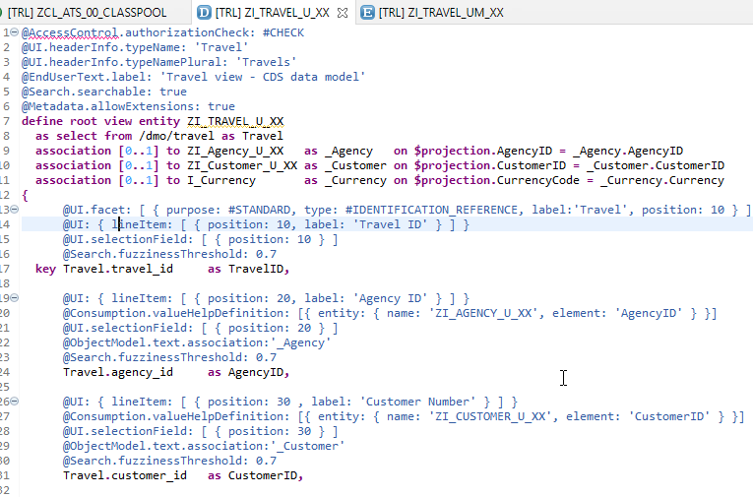
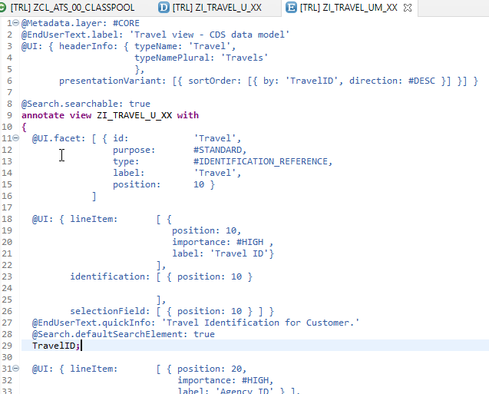
CDS Views with Annotations
Metadata Extension
Exercise
ZI_AGENCY_U_XX
ZI_TRAVEL_U_XX
ZI_TRAVEL_UM_XX

Slide 6

Local Types/Classes in ABAP with Global Classes
Local Types for Global Classes - Within class pools, as in virtually any other ABAP program, data types, local interfaces, and local classes can be defined to ensure a better structure of the implementation of the global class.
More number of classes will cause confusion and over-modularization increase the complexity of our design
More number of global classes, will increase the chance of our code being exposed to reports/classes which we may want to use only a private
Allow a modularized way of designing app but still keeping our code in a single contain, a good balance between number of classes v.s modularization.
At times we need so many classes for different purpose with very limited no of methods. 2 meh. + 20 classes, Create a class pool would be a good options.

Slide 7
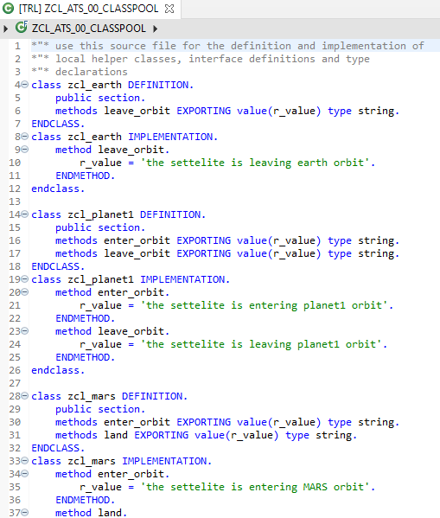
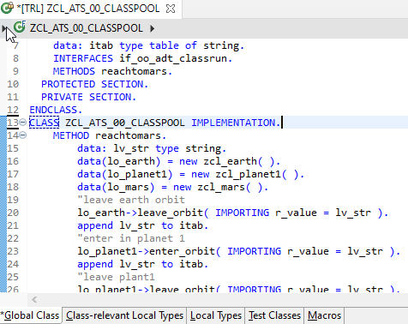
Implementing Class Pool Concept
Global Class
Exercise
Class Pool Code
Local Types/Class

Slide 8

End of Day 24
Trainer: Anubhav Oberoy

Slide 9

Trainer: Anubhav Oberoy

Slide 10
THANK YOU
If you cannot do
great things, do small things in a great way.
Anubhav Oberoy
https://www.anubhavtrainings.com

Slide 11


We’re committed to empower you to be
Most Desirable Resource
through powerful training solutions.
We build the workforce of the future.
250+
Corporate Clients
30,000+
Learners Trained
25000+
Learners Placed
FREE WEBINARS
Sign up for free webinars with industry experts every fortnight!
Enroll Now!
Contact us today!
https://anubhavtrainings.com/

Slide 12




More from AnubhavTrainings.com

